Slide 1
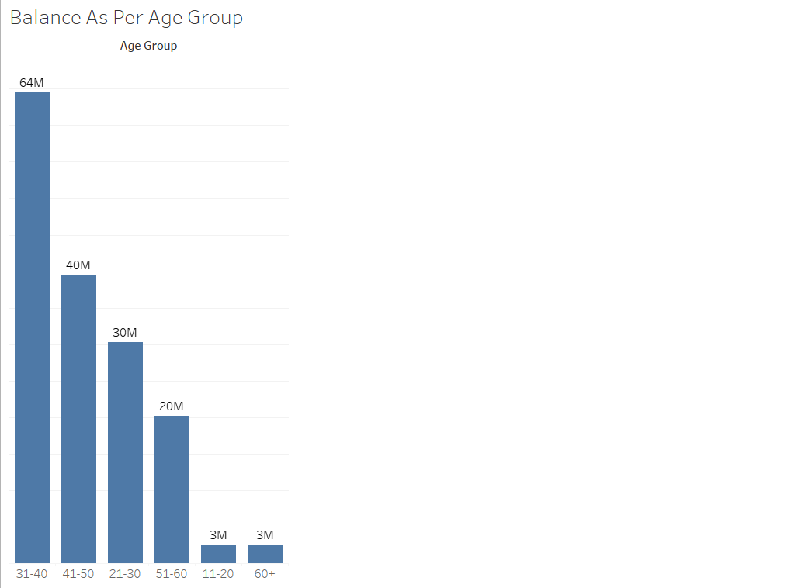
Customers of age group 31-40 are maintaining a good balance in there account. We can start a marketing campaign & target their need so that we can get more potential customers from the same age group.

Slide 2
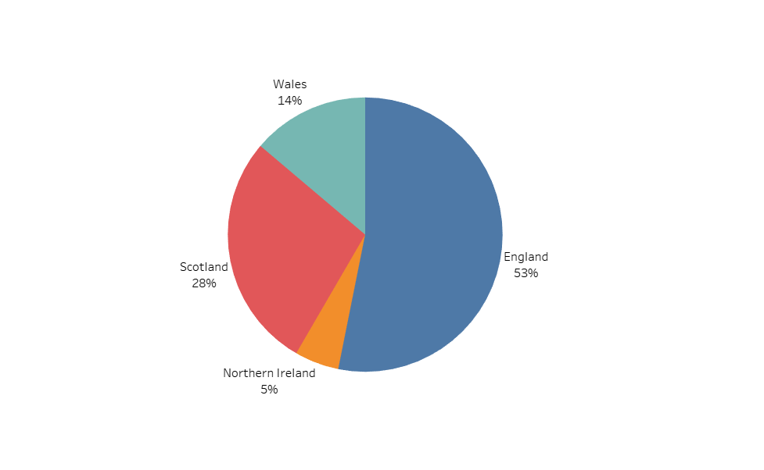
England is having more than 50% customer base & Northern Ireland is only having 5%. We can give better offer for Northern Ireland to attract more customers & overall better interest rate to attract more customers from England as well as it’s the larger area of business.

Slide 3
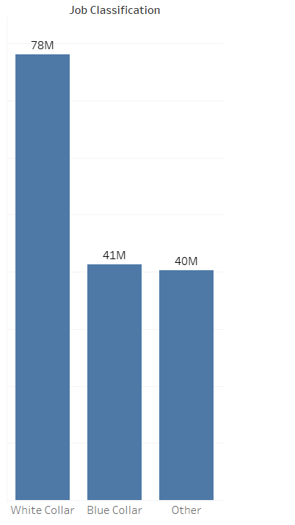
White Collar professionals are maintaining higher balance & the customer base is also highest. We can give better loan offers to them to attract more customers.

Slide 4
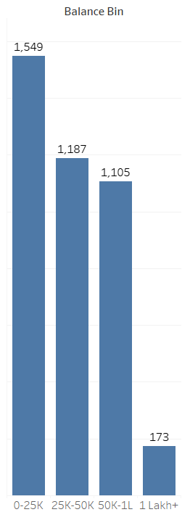
We can see very few customers are maintaining 1 Lakh+ balance. We can offer more premium services to them to attract more high value customers. Also as 1500+ customers are maintaining balance less than 25k we can waive monthly maintenance amount for new accounts so that we can attract more customers in that segment.

Slide 5
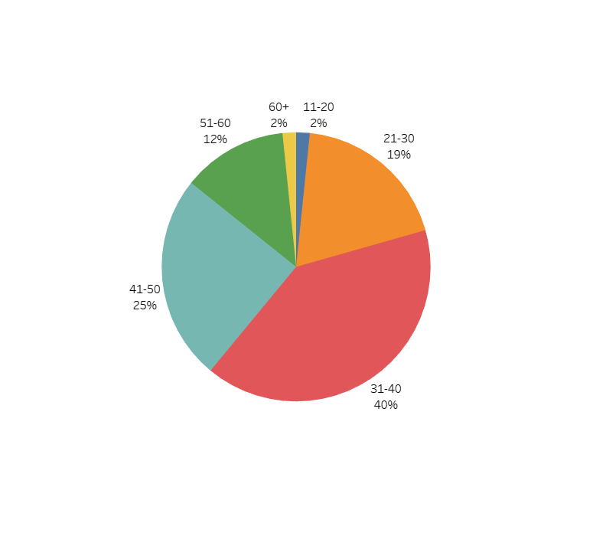
As we have only 2% customer base from both senior citizen & minor category we can give higher savings & FD interest rates for senior citizens & better facilities for minors.

